Slide 1
SQL Source Control Solutions

Slide 2
Background
Inevitably with large systems…
Relational databases
Need to leverage different kinds of schema, programmatic elements, etc.
Non-trivial complexity (e.g. P&L Reporting)
Different philosophies in terms of SQL
Considerations:
Performance
Round-trips
Knowledge
Evidence shows “we” have often treated non-SQL code differently from SQL code
If you know of “better ways”, let’s discuss - interactive

Slide 3
Goals
Reliable builds
Track down breakdowns quickly
Enable us to do some helpful things (e.g. code generation)
“Quiet” major deployments

Slide 4
Strategy Components and Definitions
Physical Databases
Dev, QA, Prod
Sandbox DB’s
File System
Under source control
“One Source of Truth”
VS 2010 Database Project
I’ve used different approaches, different situations

Slide 5
What about…
Assumption: you must always start from the file system
Good in concept – can require a shift in thinking
What works? – depends!
Assumption: a shared development database is evil
“Joel! Where’s that table??!”
Builds a “common understanding” about both schema and data, among the team
Can be useful to support things like code generation (e.g. enums from code table values)
Assumption: using prod data is evil
Often there are subtleties that are meaningful
Do I really want to work with random strings to test my queries and demo to users?
You can always obfuscate (different talk)

Slide 6
Example – efficiency
Brute force
Ensure db schema is up to date (possible compare)
Generate code gen SQL script off of db schema - seconds
Execute against database - seconds
Run a schema compare back against DB project under source control – minutes (potentially many)
Optimal
Generate code gen SQL script off db schema – seconds
Execute against database and have DB project under source control automatically updated - seconds

Slide 7
Good Path, Bad Path
“It’s the bad path that always kills us!”
Emergency fixes
Emergency “tuning”
Deployments that involve complex database requirements (i.e. a simple migration of objects won’t work)
Sloppy work – even the best can be guilty at times

Slide 8
What I really Need
A working database in which I can develop schema objects like procedures, triggers, etc. and have data that resembles true prod data as closely as possible to debug with
In fact, need multiple regions (load testing example)
Streamlined development interactions (examples)
Must be flexible enough to allow for emergencies but still rigorous enough to avoid discrepancies
Users need “stable” QA region with data that they enter and own
Must manage reference data effectively
In cases, user ownership
In other cases, dev ownership

Slide 9
Strategy #1: “Manual”
Just try to manage it all by having different databases for Dev, QA, Prod and have developers tracking their list of changed objects (in each!)
Tricky when numerous interdependent objects
Relying on perfect record keeping – this will fail, at least occasionally!

Slide 10
Strategy #2: Home-grown
Example from recent project (4 team members)
Naming conventions allowed for sharing a common database with another major system
Promoted objects changed since last deployment from dev to QA, meeting naming criteria
Handled all objects nearly flawlessly
Removed me from the build process! (.cmd file)
Build could be completed in a few minutes
From QA To Prod has to become more managed
Advantage was simplicity, team acceptance
Disadvantage is it will not scale well

Slide 11
Strategy #3: SSMS + SCS
Available for quite some time now
On a deprecated path
History of changes technically present:
Would be possible to rebuild all for every build
Does offer way to search for changes, but a bit clunky
Demo

Slide 12
Strategy #4: VS 2010 + TFS
Microsoft’s guidance:
http://vsdatabaseguide.codeplex.com
VS 2010 Database Project
Trend is to move DB development into Visual Studio
Deltas are key of the process, originating from the DB project as source (p.61)
Supports Continuous Integration, automation
Don’t assume it’s a perfect process! (example)
Is important to link objects to builds / work items
Other benefits such as validation of model prior to deploy
Demo

Slide 13
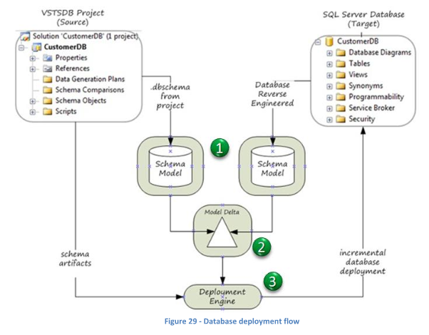

Slide 14
Strategy #5: Red Gate SQL Source
A convenient interface to manipulate the file-backed objects, from SSMS
Shared database model not encouraged
Does not expose “state” related to SCS
Other bells and whistles
Demo
Why do you think they did this??
Transparency a major driver here
Familiarity is another (may not like it, but it’s real)

Slide 15
Data Tier Applications (DAC)
Package objects in a way that let you deploy a whole database
A DAC package cannot upgrade an existing database; it will always deploy a new database with the changed schema. When you have deployed the new database schema to the server, you will have to make sure that the old data is migrated to the new database
DAC projects are intended for and targeted to small database projects. For example, they can be simply used by an ISV to populate a common standard schema to a server
Not really intended to be a build process since does not really address selective / combined / multi-branch deployments
Does not address base “source of truth” requirements in itself

Slide 16
Constraints…
Size and “will” of IT shop
Size of the project, methodology, etc.
What you have available (e.g. VS 2010?)
Observation: “we” often shy away from complexity even at the expense of some problems down the road

Slide 17
Another Possible Approach
Still evolving: www.codexframework.com/sqlhero
Design Goals:
Work in environment that integrates with VS 2010 Database Projects (and TFS source control)
Leverage best of guidance
Allow me to still execute T-SQL scripts which can in turn update the 2010 DB Project source of truth
Code Generation (SQL-based objects / data)
Tool for DBA’s who may make changes out-of-band
Lets one work in both “old” and “new” ways

Slide 18
Implementation (2)
Design Goals, continued:
If you’re off-line, should still be able to work with a functional sandbox database and have changes be tracked and later applied to SCS
Plug-in based, meaning different kinds of SCS can be supported (TFS, SVN, VSS)
Centralized admin / config, as much as possible
Command-line options
Avoid the issues with shared dev databases
Address lots of the “little things”
Demo

Slide 19
Traditional #1
Development effort
Commit
Builds
Production
Dev
Out-of-band
(e.g.
hot-fixes
only)
Builds
Source Control
Repository
Staging / Testing

Slide 20
Traditional #2
Development effort
Builds
Production
Commit
Sandboxes
Out-of-band
(e.g.
hot-fixes
only)
Builds
Source Control
Repository
Staging / Testing

Slide 21
One Alternative
Development effort
Automatic update
(Explicit commit)
Production
Builds
Dev
Out-of-band
(e.g.
hot-fixes
only)
Builds
“Automatic” update
Source Control
Repository
Staging / Testing

Slide 22
Region Differences Checking
Protection against possible changes made “out of band”, directly against database(s) – “Model Drift” (p.88)
Technically possible regardless of your SC strategy
Most often this would occur in DB not under SC anyway
Proposal: nearly instant alerting possible, directed to relevant parties and informing about specifically who made changes (people often pay attention to emails)
Does not have to be just a “database compare”
We have rich info available about what actually happened
Two kinds, really:
Database-to-database differences (e.g. QA to Prod)
Source-of-Truth-to-database (e.g. SC to QA and/or Dev)
Demo

Slide 23
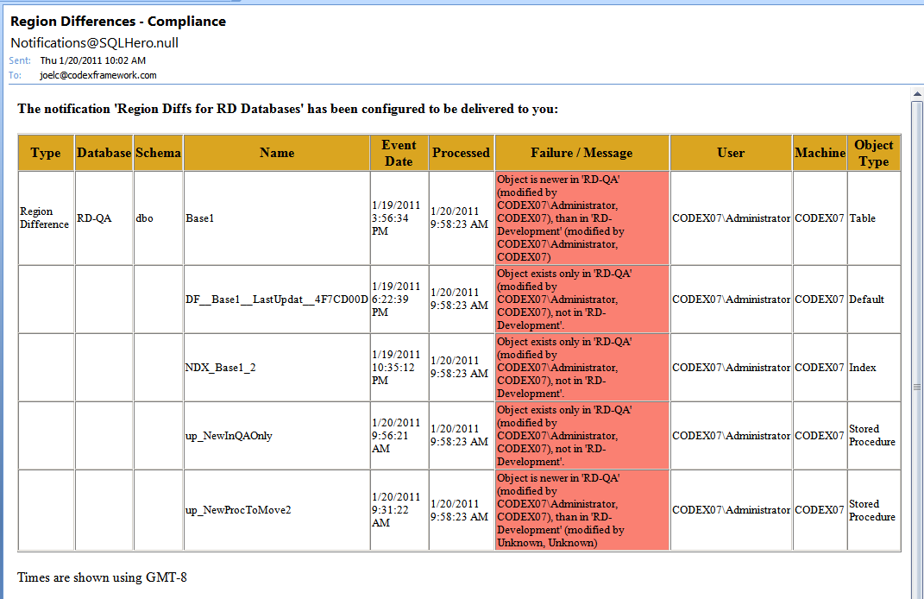

Slide 24
Other Requirements
“True audit history” – search for changes
Ideal: Union of SC changes and actual schema changes
Demo
Graphical view of changes (since last build, for example) and reporting
Demo

Slide 25
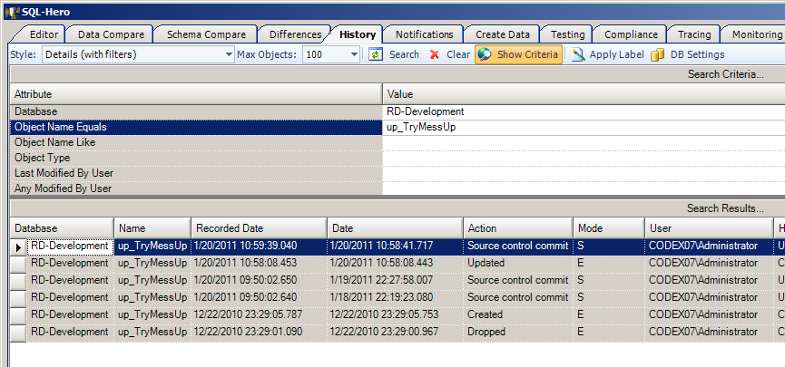

Slide 26
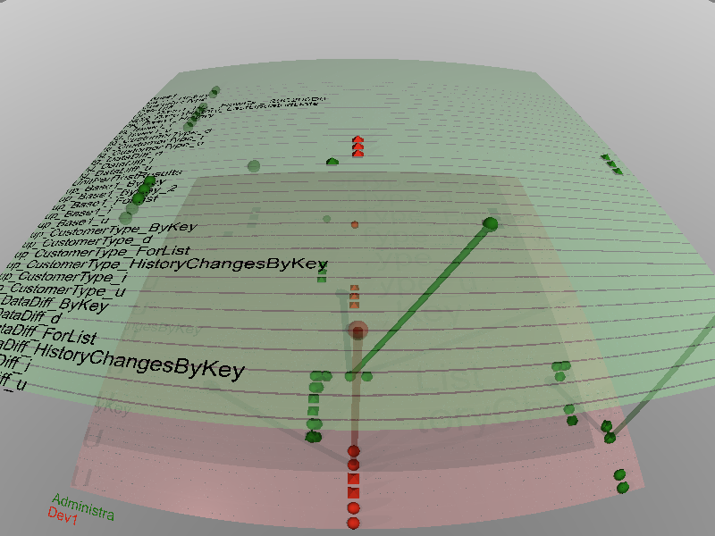
Shape = Action (including in actual db and in SCS), Cylinders = Same Change Applied Across DB,
Transparent = Untested / Unexecuted, Color = Developer Name, Axes = Object / Time

Slide 27
What’s YOUR ideal??
I still have colleagues asking me, “have you found a magic bullet yet??”
(and these are guys using guidance)
Statefulness comes into play
Use of “What I Really Need” slide and insert your own experiences to measure

Slide 28
If this was interesting…
I’m looking to put on a full-day session!
Agenda:
SQL Source control (this session++)
Stress testing with large volumes of test data (generating data)
SQL unit testing frameworks
Optional breakout session on SQL-Hero: all the gory details
Full details: see URL below
If this sounds interesting, please pre-register – cost is kept to minimum, lunch included
Full-day training: April 23, 2011 – Corte Madera
www.codexframework.com/training
If you liked the talk, blog about it! If you didn’t please provide constructive criticism! (www.codexframework.com/feedback)
Follow on Twitter: @sqlheroguy
E-mail: joelc@codexframework.com

Slide 29
Q & A

