Slide 1
A SQL Server Performance Warehouse Using the SSAS Tabular Model
CodeX Enterprises LLC
2013

Slide 2
Agenda
Concepts
How I Implemented Reporting Proof-of-Concept
SQL-Hero® Architecture
SQL-Hero® Demo
Big Picture & Future

Slide 3
Concepts

Slide 4
Hierarchy of Needs: Monitoring
Discrete events
Problem diagnosis (order of calls, actual parameter values, etc.), replay, accurate measures of activity, different event types
SQL Profiler, Extended Events
Pay performance penalty for both evaluating filters and storing
Aggregate performance
Bottlenecks, trends in metrics (eg. Increase in durations over time), overall health
DMV’s, custom solutions, third-party tools
Does not include some attributes: Host Name, Application Name, etc.
Weakness tends to be “deep / ad hoc analysis” – model-based
Different environments will make different demands
Capacity planning for monitoring

Slide 5
Tracing (SQL Profiler)
Been around a long time
System stored procedures (not easy to use: eg. magic numbers for parameters), or client tool (with its own limitations)
Deprecated soon (a few versions out)
Includes things like “reports” – blocking and deadlocks
SQL-Hero has supported for a long time too
SQL-Hero value-add includes “shredding” reports into more meaningful form, across server restarts, etc.
More analysis & reporting options

Slide 6
Extended Events
Re-written tracing system (debut MS SQL 2008)
DDL instead of procs
Lower overhead, more options
SQL-Hero adds support to collect in a way that seems like event stream, although it’s backed with file_target and all of its benefits

Slide 7
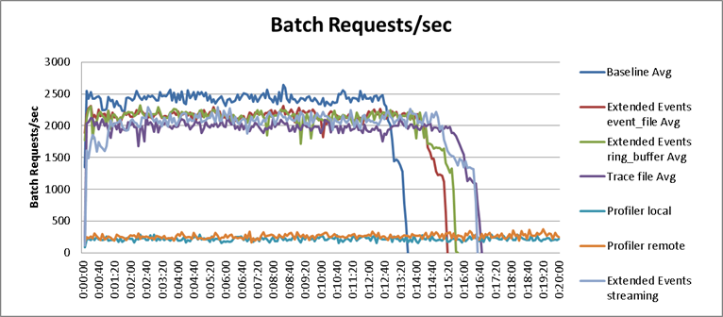
(from http://www.sqlperformance.com/2012/10/sql-trace/observer-overhead-trace-extended-events - Jonathan Kehayias)

Slide 8
DMV Queries
Data Management Views
Wide range of health queries possible
Are what most performance related tools actually use
The actual use of them can have varying impact on running systems
Example: sys.dm_exec_query_stats

Slide 9
A Problem with Storing Away Raw DMV Results…
Quantity of data becomes an issue
Example using sys.dm_exec_query_stats…
20,000 rows X 38 columns per sample
1 sample every 10 minutes
Result: 109,440,000 data points per instance per day – could turn into many Gb per day!
Things that could help…
Only care about changes in values
Roll-up, filter (e.g. to procedure level)
Keep this detailed data for short time (short-term diagnosis) but keep the changes for longer
Caveats
E.g. What happens on server recycle / cache flush?
DMV’s can’t tell us everything that events can: e.g. “Application Name”

Slide 10
Background: Column-store Databases
Example…
Why is this good?
Data compression as a byproduct, consumes far less memory, produce less I/O
Tenants of Big Data – denormalization is expected
Examples… Microsoft: VertiPaq / xVelocity; Hadoop: HBase
SQL 2012 (T-SQL) – Columnstore Indexes (read-only); 2014 – Updateable columnstore
ID | Name | City | Value
3 | Frank | Albany | 15
2 | Fred | Albany | 15
1 | Bob | SF | 15
4 | Frank | SF | 15
5 | Ted | SF | 16
ID | Name | City | Value
1 | Bob | SF | 15
2 | Fred | Albany | 15
3 | Frank | Albany | 15
4 | Frank | SF | 15
5 | Ted | SF | 16
ID | 1 | 2 | 3 | 4 | 5
Name | Bob | Fred | Frank (2) | Ted
City | SF | Albany (2) | SF (2)
Value | 15 (4) | 16

Slide 11
Background: SSAS, Power Pivot, the Tabular Model
Power Pivot – Excel 2010 Add-in
Demos: billions of rows handled well – in-memory focus
Technology of Power Pivot (VertiPaq) makes its way into SSAS in 2012 as “Tabular Model”
Excel 2013 – Power Pivot more integrated
Multidimensional: Aggregations; Tabular: “xVelocity’ing”
A premise behind Tabular is it’s “easier to understand” which is consistent with Microsoft’s data story
Language of Multidimensional is MDX, for Tabular / Power Pivot is DAX
Can use MDX against Tabular
DAX looks and feels a lot more like “Excel functions”
Multidimensional SSAS can still do some things Tabular cannot (eg. Security)
Future: both will support DAX natively

Slide 12
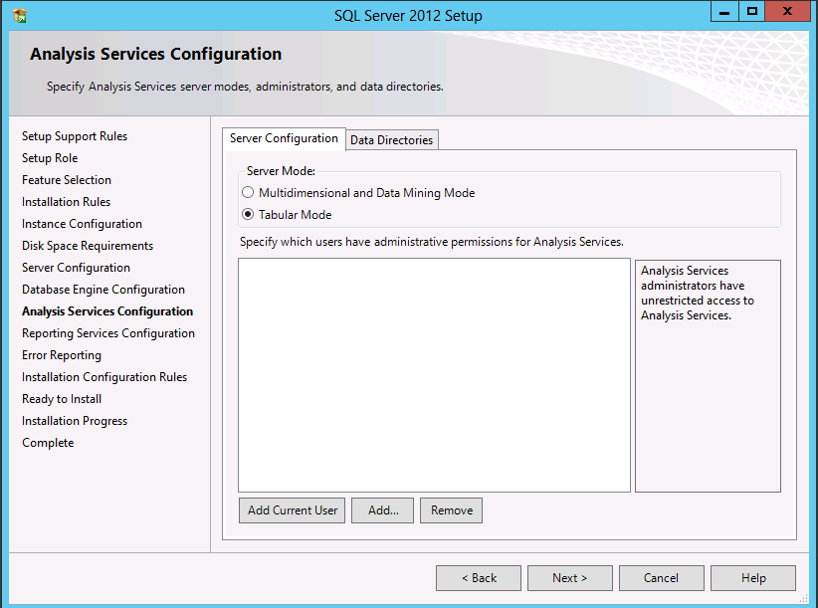

Slide 13
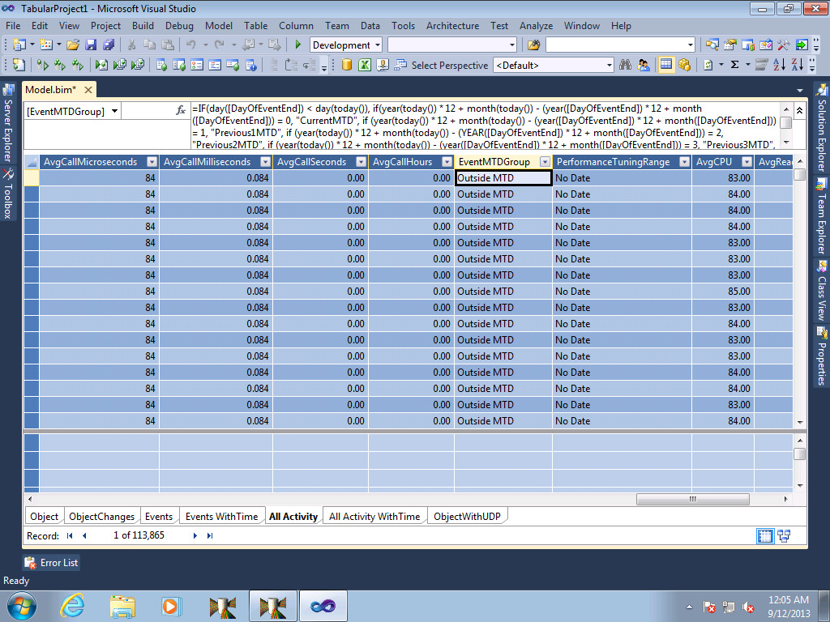

Slide 14
How I Implemented a Proof-of-Concept

Slide 15
What was Available…
SQL Profiler collected RPC:Completed events for everything 5+ seconds, plus Blocking, Deadlock reports
Roughly 2,000 events per day over all systems / databases
Stored in one big table (per instance), but also copied into SQLHeroMgmt via background process

Slide 16
What was Created…
SQL Job to populate a very wide fact table
No dimension tables
Load the fact table into Excel (2010) using Power Pivot add-in
Build Pivot Tables / Charts from Power Pivot data
Performance over 1,000,000 rows (rolling 12 months): excellent!

Slide 17
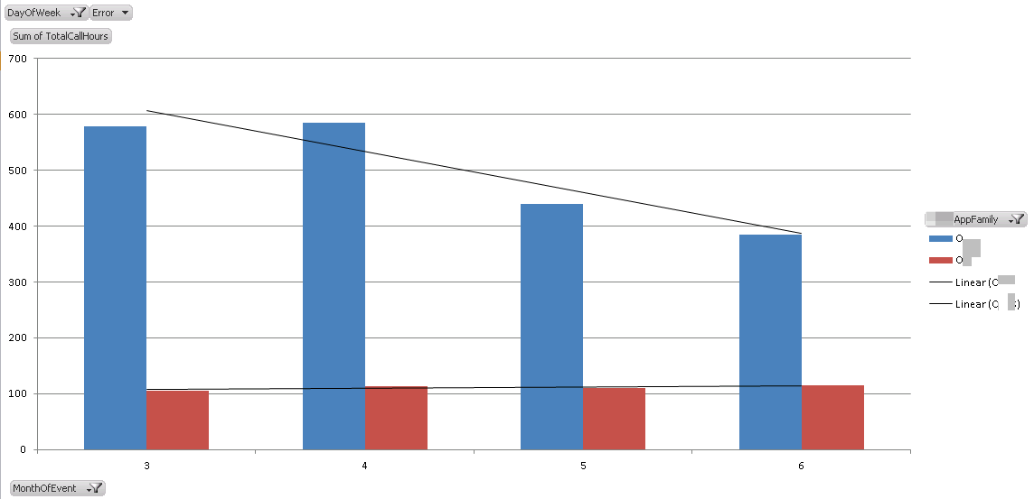
Examples of Reports Could Produce…

Slide 18
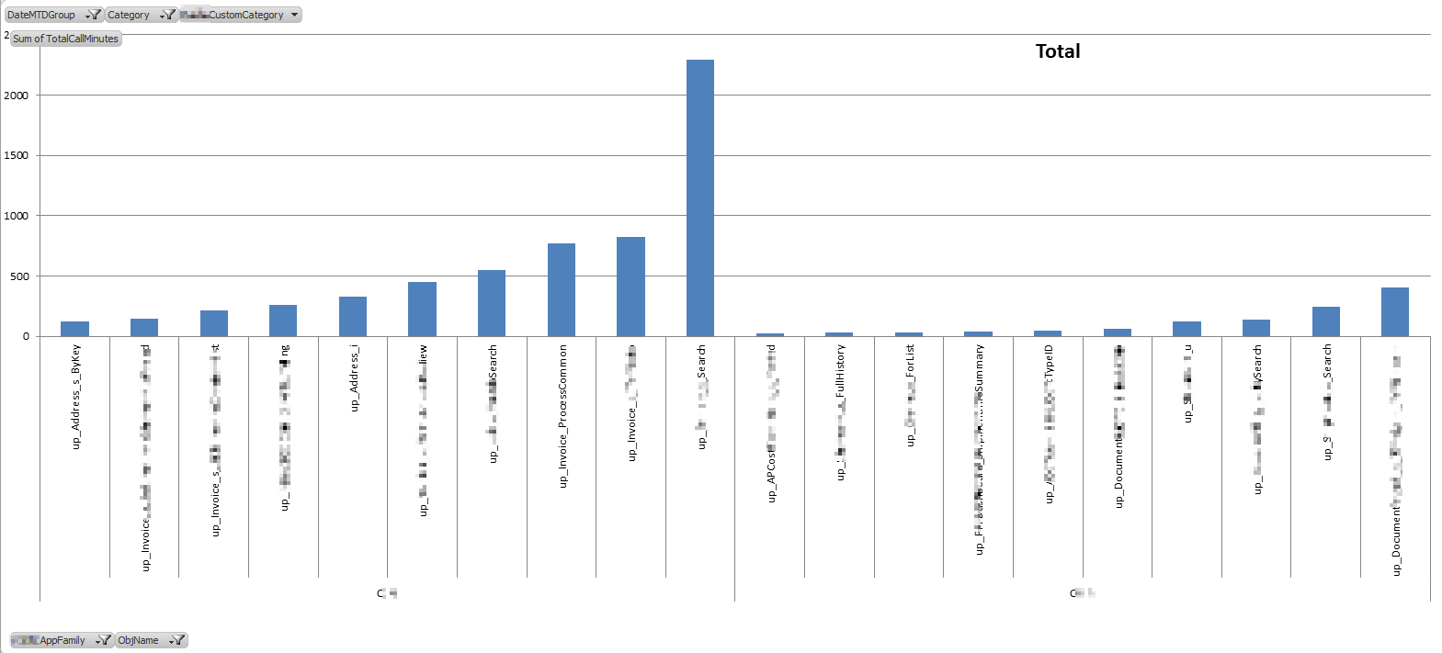
Another example…

Slide 19
Another Concept… “Tuning Date”
The next report uses the concept of a Tuning Date to show how much impact some tuning effort actually made, by object
In some cases re-wrote, some cases adjusted indexing, etc.
In all cases, wanted to compare “before” and “after” timings
Needed to have a “fair” way to evaluate timings (apples-to-apples)
Still assumes “uniform usage”!
Unfair!!
Unfair!!
Fair!!
Fair!!
“Before”
“Before”
“Before”
Change made
Change made
“After”
“After”
“Before”
Change made
“After”
Change made
“After”

Slide 20
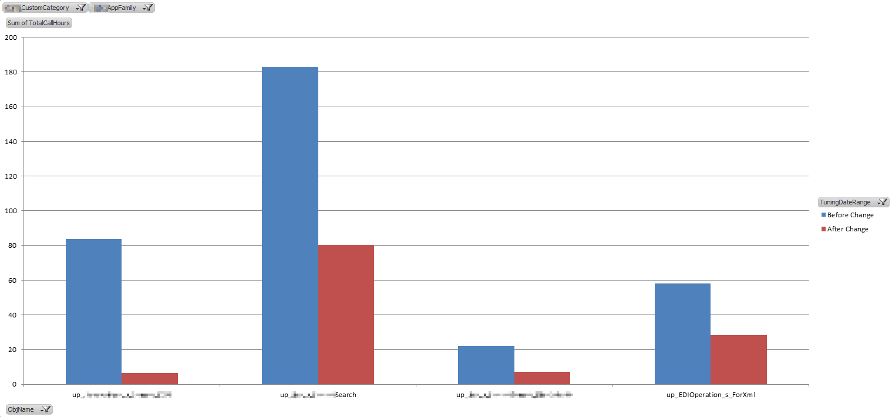
“Tuning Date” Example…

Slide 21
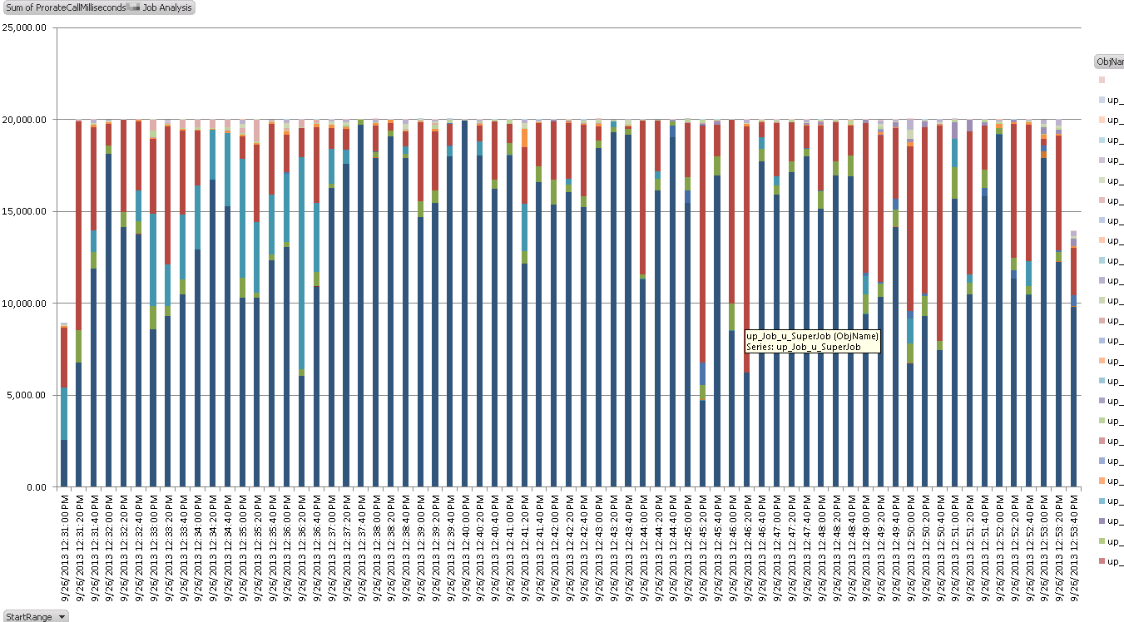
A Final Example…

Slide 22
Relevant SQL-Hero Architecture

Slide 23
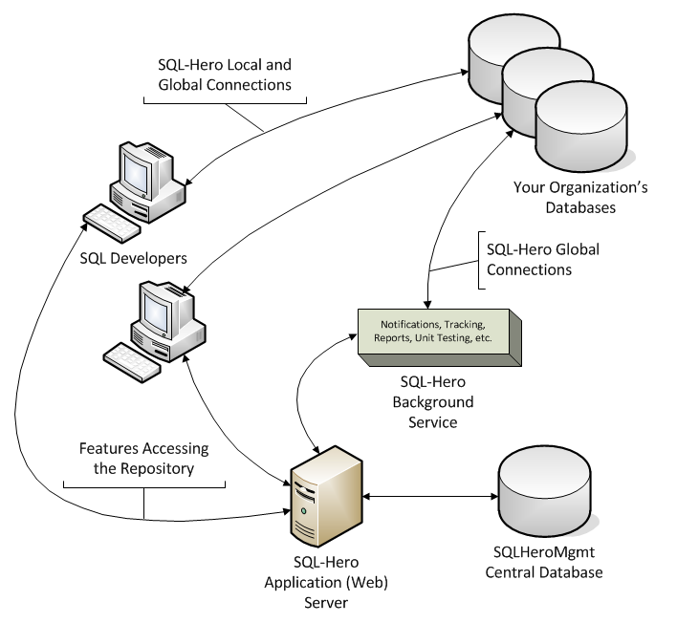
Architecture (1)
Similar to TFS
Web Services
Database
Windows Service

Slide 24
Architecture (2)
DMV Aggregator
Other Aggregators
Log Files
SQLHeroMgmt
Hadoop
Monitoring
Monitoring
Monitoring
Monitoring
Other Visualizers
Purging
Tracing
Tracing
Tracing
Tracing
SQL Profiler
SQL Profiler
User Mart
SQL Server Analysis Services
Extended Events
Files
Data Warehouse
Tabular Model
External Tools
= new in 0.9.9
= future feature or not directly supported
= millions / billions of transactions
= thousands / millions of transactions
“Performance daggor™” (Data Aggregator)
… not just about MS SQL anymore!

Slide 25
What’s Different from POC?
Uses SSAS Tabular Model instead of Power Pivot
Uses dynamic SQL for ETL
Uses dynamic XMLA for deployment of SSAS cube
Richer set of tables and attributes
More normalization, using multiple tables
UDP’s can be marked to be exposed in model as attributes
Model can be user-extended using DAX expressions
Supports in-coming “trace” data that’s actually not trace data…
Comes from DMV queries such as sys.dm_exec_query_stats
Can let user pick multiple sessions to combine into tables within the model and adjust some other “dials”

Slide 26
Why Build It This Way?
My goal: don’t build if “already done”, but…
Generic nature = non-SQL data sources
The model can evolve independently
The model has specialized intelligence (eg. tuning dates, etc.)
Solves specific problems such as “tell me how much of an impact my tuning effort actually made for object XYZ”
Solves problem of “too much” or “too little” monitoring
You can choose how frequently to sample (and/or trace)
DMV (monitoring) data can be “pruned” as it is transformed into a more compact format: the tracing data store

Slide 27
Solution Summary
Transactional data
“Raw performance data”
ETL
“Make some sense, add some value”
Secret sauce: Configurable, meta-data, specialized intelligence
XMLA
“Define the cube structure”
The Cube
“The end product to report against!”
Includes some things also available in SQL-Hero (object changes, work items, etc.)
Option to include some specialized time-based analysis
Will offer additional sessions on gory details – too many to cover now!

Slide 28
Demo

Slide 29
Videos
Zero to Full-on Reporting (or: “Debunking the Complexity Myth”)
Deeper Dive: Proving that the Reporting Results are Consistent
More videos to follow on www.codexframework.com

Slide 32
Big Picture & Future

Slide 33
What's the "Big" Deal?
Other data sources can be “compatible” with the model… including “Big Data” sources
Anything that’s got a “duration” & (optionally) “count”
“Big data” converted into “smaller data” using aggregators
Dynamic nature of the model (i.e. “columns magically appear”!)
A good fit for the Tabular Model
SQL-Hero performance is quite good
Can collect 100’s of millions of data points
Can upload millions of data points per minute
Provisioning needs based on how far you expect to push things

Slide 34
Taking These Concepts into Your Environments
Tabular Model is a good fit for many reporting needs
Notion that you have to do Big Data using something like Hadoop is misleading: SSAS can be viable in right contexts (eg. structured vs. unstructured)
You can do an “import” from what I’ve generated if you’re looking for some ideas

Slide 35
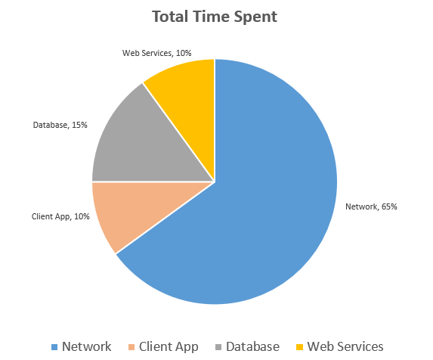
SQL-Hero Roadmap for 1.1, 2.0
With new aggregator plug-ins, goal would be to be able to have the model allow for this kind of report:
Drill-down / drill-through to details
(eg. Maybe it’s “network” in a specific
geography skewing totals)
Enhance“Performance daggor™”
Leverage MS SQL 2014

Slide 36
Resources
Upcoming blog (sqlheroguy.com) articles to look for:
Analyzing “Big” SQL performance data using Hadoop / HDInsight
Performance tuning your SQL and ways to measure improvements using SQL-Hero BISM reporting
Why back up your development databases when you can restore them from SQL-Hero audit history?
SSIS Components available in SQL-Hero
SQL-Hero related
www.codexframework.com, www.daggor.com
joelc@codexframework.com
@sqlheroguy (Twitter)
Sqlheroguy.com (Wordpress)
Planning a meetup.com launch & training events (check on site)
Other
MDX vs. DAX: https://skydrive.live.com/view.aspx?cid=5BB64CF526505D83&resid=5BB64CF526505D83%21921&app=PowerPoint
Engine behavior: http://bistuffwithdigven.wordpress.com/category/dax/

Slide 37
Special Offers
Until Oct 31, 2013 can use coupon code “INTRO1.0”
What’s the most important favor you can do for me? Talk about it with others!
Please provide presentation feedback!
What’s most important for a good product? FEEDBACK PLEASE!

Slide 38
Thank you!

